Slide 1
CSS
Cascading Style Sheets

Slide 2
HTML markup can be used to represent
Semantics: h1 means that an element is a top-level heading
Presentation: h1 elements look a certain way
It’s advisable to separate semantics from presentation because:
It’s easier to present documents on multiple platforms (browser, cell phone, spoken, …)
It’s easier to generate documents with consistent look
Semantic and presentation changes can be made independently of one another (division of labor)
User control of presentation is facilitated

Slide 3
What is CSS?
It makes a webpage look good.
HTML - Structure of webpage- Required
CSS – Styling of the webpage – Optional
CSS introduced in 1996
CSS3 – evolving– modules and dynamic
Index.html - html
Code,css
<style> ….. </style>

Slide 4
Outline
Basics
Advanced – with Javascript
Flexbox, CSS grid, Sass - Introduction

Slide 5
Basics
Style Rules - two parts – selector and declaration
Selector { property :value;}
The Selector indicates the element to which the rule is applied.
The Declaration determines the property values of a selector

Slide 6
The Property specifies a characteristic, such as color, font-family, and position, and is followed by a colon (:).
The Value expresses the specification of a property, such as red for color, arial for font family, 12 pt for font size, and is followed by a semicolon (;).
CSS declarations always ends with a semicolon, and declaration groups are surrounded by curly brackets:

Slide 7
E.g.
p {color:red; text-align:center;}
Or
P
{
color:red;
text-align:center;
}

Slide 8
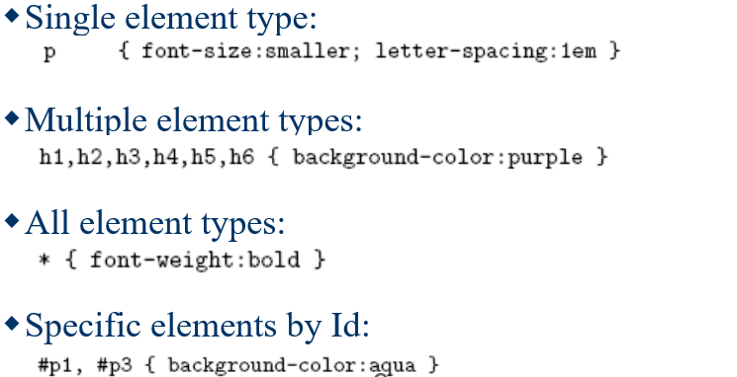
Selector types

Slide 9
CSS Comments
A CSS comment begins with "/*", and ends with "*/", like this:
/*This is a comment*/

Slide 10
id selector and class selectors
In addition to setting a style for a HTML element, CSS allows you to specify your own selectors called "id" and "class".
The id Selector
The id selector is used to specify a style for a single, unique element.
The id selector uses the id attribute of the HTML element, and is defined with a "#".
Example
The style rule below will be applied to the element with id="para1":
#para1 { text-align:center; color:red; }

Slide 11
<!DOCTYPE html>
<html>
<head>
<style>
#para1 {
text-align: center;
color: red;
}
</style>
</head>
<body>
<p id="para1">Hello World!</p>
<p>This paragraph is not affected by the style.</p>
</body>
</html>

Slide 12
Class Selector
The class selector is used to specify a style for a group of elements.
Unlike the id selector, the class selector is most often used on several elements.
This allows you to set a particular style for any HTML elements with the same class.
The class selector uses the HTML class attribute, and is defined with a "."

Slide 13
<!DOCTYPE html>
<html>
<head>
<style>
.center {
text-align: center;
color: red;
}
</style>
</head>
<body>
<h1 class="center">Red and center-aligned heading</h1>
<p class="center">Red and center-aligned paragraph.</p>
</body>
</html>

Slide 14
In the example below, all HTML elements with class="center" will be centeraligned:
Example .center { text-align:center; }
In the example below, all p elements with class="center" will be centeraligned:
Example
p.center {text-align:center;}

Slide 15
Egs
<
#top { background-color: #ccc; padding: 20px }
.intro { color: red; font-weight: bold; }
<div id="top">
<h1>CSS topic</h1>
<p class="intro">Style sheets</p>
<p class="intro">External Internal Inline</p> </div>

Slide 16
Three ways to Insert CSS
Inline style
Internal style sheet
External style sheet

Slide 17
Inline CSS
Inline CSS
An inline style may be used to apply a unique style for a single element.
To use inline styles, add the style attribute to the relevant element. The style attribute can contain any CSS property.
<!DOCTYPE html>
<html>
<body>
<h1 style="color:blue;text-align:center;">This is a heading</h1>
<p style="color:red;">This is a paragraph.</p>
</body>
</html>

Slide 18
Internal CSS
<!DOCTYPE html>
<html>
<head>
<style>
body {
background-color: linen;
}
h1 {
color: maroon;
margin-left: 40px;
}
</style>
</head>
<body>
<h1>This is a heading</h1>
<p>This is a paragraph.</p>
</body>
</html>
An internal style sheet may be used if one single HTML page has a unique style.
The internal style is defined inside the <style> element, inside the head section.

Slide 19
External CSS
<!DOCTYPE html>
<html>
<head>
<link rel="stylesheet" href="mystyle.css">
</head>
<body>
<h1>This is a heading</h1>
<p>This is a paragraph.</p>
</body>
</html>
Mystyle.css
body { background-color: lightblue; } h1 { color: navy; margin-left: 20px; }

Slide 20
Inline style
<p style="color:blue;font-size:46px;">
I'm a big, blue, <strong>strong</strong> paragraph
</p>

Slide 21
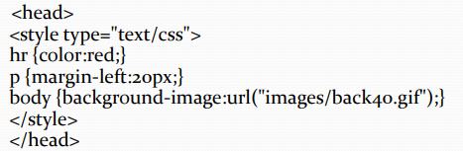
Internal Style Sheet
An internal style sheet should be used when a single document has a unique style.
Internal CSS is a method for defining CSS styles directly within an HTML document.
It’s particularly useful for applying unique styles to a single web page, and it’s embedded within the
<style> element located in the <head> section of the HTML file.

Slide 22
External Style Sheets
An external style sheet is ideal when the style is applied to many pages.
With an external style sheet, you can change the look of an entire Web site
by changing one file.
Each page must link to the style sheet using the tag.
The tag goes inside the head section:
An external style sheet can be written in any text editor.
The file should not contain any html tags.
Your style sheet should be saved with a .css extension.
An example of a style sheet file is shown below:
hr {color:red;}
p {margin-left:20px;}
body {background-image:url("images/back40.gif");}

Slide 23
External and Internal Style sheets
For example,
an external style sheet has these properties for the h3 selector:
h3 { color:red; text-align:left; font-size:8pt; }
And an internal style sheet has these properties for the h3 selector:
h3 { text-align:right; font-size:20pt; }
If the page with the internal style sheet also links to the external style sheet, the properties for h3 will be: ?

Slide 24
color:red; text-align:right; font-size:20pt;
The color is inherited from the external style sheet and the text-alignment and the font-size is replaced by the internal style sheet.

Slide 25
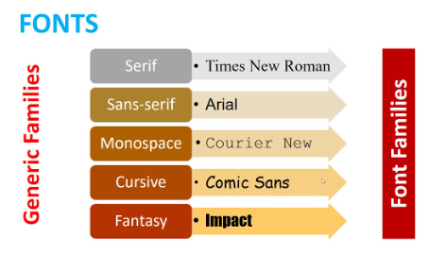
Font Family
The font family of a text is set with the font-family property.
The font-family property should hold several font names as a "fallback" system.
If the browser does not support the first font, it tries the next font.

Slide 26
General Font family setting
font-family : family-name| generic family| initial | inherit
eg
p{font-family:"Times New Roman", Times, serif;}
Initial – default
Start with the font you want, and always end with a generic family, to let the browser pick a similar font in the generic family, if no other fonts are available.

Slide 27
E.g.
<html> <head> <link rel="stylesheet" type="text/css" href="style1.css"> <style> body {background-color: black; background-repeat:no-repeat;} h1 {style="font-family:times,Serif";} </style> </head> <body style="background-color: blue; background-repeat:no-repeat;"> <h1 style="font-family:georgia,garamond,serif;"> Sample Document </h1> </body> </html>

Slide 28
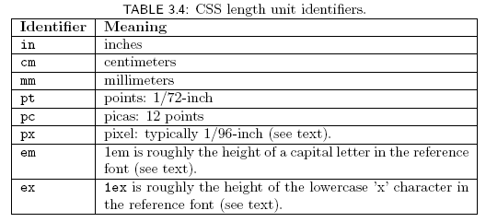
Font-size
Many properties, such as font-size, have a value that is a CSS length
All CSS length values except 0 need units

Slide 29
Advanced CSS
CSS Grid: Two-dimensional layout system for creating grid-based layouts with rows and columns.
display: grid;
The <div> tag defines a division or a section in an HTML document.
The <div> tag is used as a container for HTML elements - which is then styled with CSS or manipulated with JavaScript.

Slide 30
<!DOCTYPE html>
<html>
<head>
<style>
.container {
display: grid;
grid-template-columns: auto auto auto ;
background-color: dodgerblue;
padding: 10px;
}
.container > div {
background-color: red;
border: 1px solid black;
padding: 10px;
font-size: 30px;
text-align: cebter;
}
</style>
</head>
<body>
<h1>Grid Layout</h1>
<div class="container">
<div>1</div>
<div>2</div>
<div>3</div>
<div>4</div>
<div>5</div>
<div>6</div>
<div>7</div>
<div>8</div>
</div>
</body>
</html>

Slide 31
Flexbox
Flexbox: flexible box One-dimensional layout model for distributing space and aligning elements along a single axis.
provides web authors with control over how elements are positioned, aligned, and sized within their container. It allows you to do things like, specify how elements are aligned vertically and horizontally, change their order of appearance, change the direction in which all elements are laid out, and more.
display: flex;

Slide 32
Sass
Sass: Sass stands for "Syntactically Awesome Stylesheets,"CSS preprocessor with advanced features, like variables, nesting, and mixins, to enhance the efficiency and maintainability of your stylesheets.
These technologies are widely used in modern web development to create more sophisticated layouts and manage styles more effectively.

Slide 33
Advantages
CSS saves time When most of us first learn HTML, we get taught to set the font face, size, color, style etc. every time it occurs on a page. This means we find ourselves typing (or copying and pasting) the same thing over and over again.
With CSS, you only have to specify these details once for any element. CSS will automatically apply the specified styles whenever that element occurs.
Pages load faster
Less code means faster download times.
Easy maintenance
To change the style of an element, you only have to make an edit in one place.
Superior styles to HTML
CSS has a much wider array of attributes than HTML.

Slide 34
Disadvantages
Browser compatibility Browsers have varying levels of compliance with Style Sheets.
This means that some Style Sheet features are supported and some aren’t.
To confuse things more, some browser manufacturers decide to come up with their own proprietary tags.

Slide 35
For your profile page…
Create a new CSS file named "styles.css."
Link the CSS file to your HTML document using the <link> tag in the <head> section.
Apply the following styles to your webpage using CSS:
Set a background image for the entire page.
Center-align the text in the header.
Style the tagline text to have a larger font size and different color.
Apply a different background color to the "About Me" section.
Style the skills list to have bullet points and a different font.
Use a grid or flexbox layout to arrange the projects in a visually appealing way.
Apply a consistent font to all text on the page.
Style the contact information to have a distinct appearance.
Experiment with additional CSS properties to enhance the overall visual design.

Slide 36
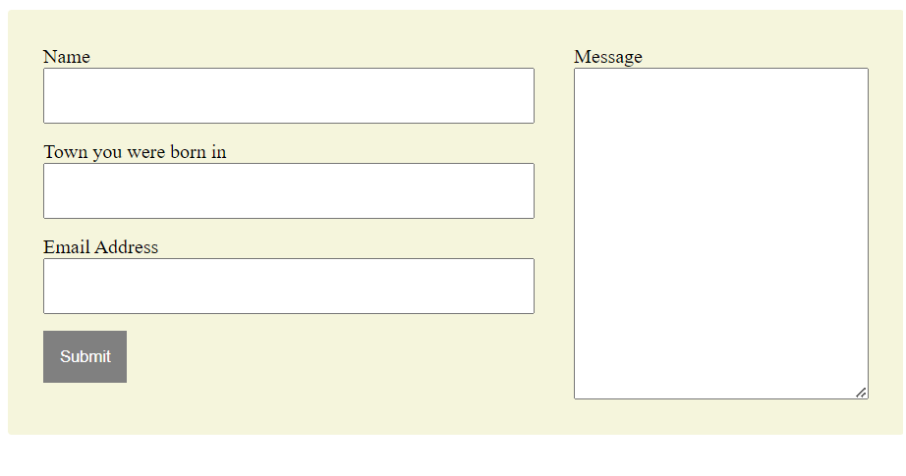
Modify the Contact us page using flexbox

Slide 37

Display all Amrita campuses with a CSS grid layout.
Bengaluru Campus in the centre( big size) – all other campuses on the sides(small blocks) as shown in Figure.

Slide 38


CSS Opacity / Transparency
The opacity property specifies the opacity/transparency of an element.
The opacity property can take a value from 0.0 - 1.0. The lower the value, the more transparent
The opacity property is often used together with the :hover selector to change the opacity on mouse-over:
<html>
<head>
<style>
img {
opacity: 0.5;
}
img:hover {
opacity: 1.0;
}
</style>
</head>

Slide 39
Representation of colors in CSS
At the element level, everything in HTML can have color applied to it.
RGB color
Hex color
HUE color

Slide 40
RGB color
RGB color values are supported in all browsers.
An RGB color value is specified with:
rgb(red, green, blue)
Each parameter (red, green, and blue) defines the intensity of the color with a value between 0 and 255.
For example, rgb(255, 0, 0) is displayed as red, because red is set to its highest value (255), and the other two (green and blue) are set to 0.
Another example, rgb(0, 255, 0) is displayed as green, because green is set to its highest value (255), and the other two (red and blue) are set to 0.
To display black, set all color parameters to 0, like this: rgb(0, 0, 0).
To display white, set all color parameters to 255, like this: rgb(255, 255, 255).

Slide 41
Hexadecimal color
Hexadecimal color values are supported in all browsers.
A hexadecimal color is specified with:
#rrggbb
Where rr (red), gg (green) and bb (blue) are hexadecimal integers between 00 and ff, specifying the intensity of the color.
For example, #ff0000 is displayed as red, because red is set to its highest value (ff), and the other two (green and blue) are set to 00.
Another example, #00ff00 is displayed as green, because green is set to its highest value (ff), and the other two (red and blue) are set to 00.
To display black, set all color parameters to 00, like this: #000000.
To display white, set all color parameters to ff, like this: #ffffff.

Slide 42
eg
<style> div { background-color: #00bfff; color: #ffffff; } </style>

Slide 43
HSL Color
HSL color values are supported in Edge, Chrome, Firefox, Safari, Opera 10+, and in IE9+.
HSL stands for Hue, Saturation, and Lightness.
HSL color values are specified with:
hsl(hue, saturation, lightness)

Slide 44
HSL
Hue - It is a degree on the color wheel from 0 to 360
0 or 360 is Red
120 is green
240 is blue
Saturation – it is the intensity of the color – 0% to 100%
Lightness – amount of light on the color
0% (dark-no light)
50% neither dark nor light
100% full light
color: hsl(0, 50%, 50%);

Slide 45
color (not supported in html)
HWB (Hue, Whiteness, Blackness) is
CMYK colors is a combination of CYAN, MAGENTA, YELLOW , and BLACK.
suggested standards for CSS4.
Computer screens display colors using RGB color values. Printers often presents colors using CMYK color values.

Slide 46
Create a website to work on class and ID selectors
Define three different font styles using CSS classes (Intro, Para, Summary).
2Apply each class to different paragraphs in your HTML document.
3Choose distinct font families, sizes, and colors for each class.
4Create two distinct font styles using CSS IDs (fig and tab).
5Apply these IDs to specific headings of the images and tables in yout web page
6Experiment with different font weights, styles (italic, bold), and text decorations.
7Select a specific element (e.g., a list item) and apply both a class and an ID to showcase the combination of styles.
8Ensure that the combination results in a visually appealing and well-coordinated text presentation.
Take contents from the following pdf:
https://www.diva-portal.org/smash/get/diva2:990768/FULLTEXT01.pdf

